Slide 1
PROJECT-I • ZEROTH REVIEW
Smart Attendance System
Using Face Recognition
AI + COMPUTER VISION
FACE RECOGNITION
AUTOMATED ATTENDANCE
Presented by
Project Guide
A. Kannan — 95192309015
R. Muthu Bala — 95192309028
M. Santhosh — 95192309044
K. Akash — 95192309701
Mrs. V. Devi Nandhini, M.E.
Assistant Professor, Department of AI & DS
Institution
P.S.R. Engineering College, Sivakasi
Department of Artificial Intelligence and Data Science | P.S.R. Engineering College, Sivakasi

Slide 2
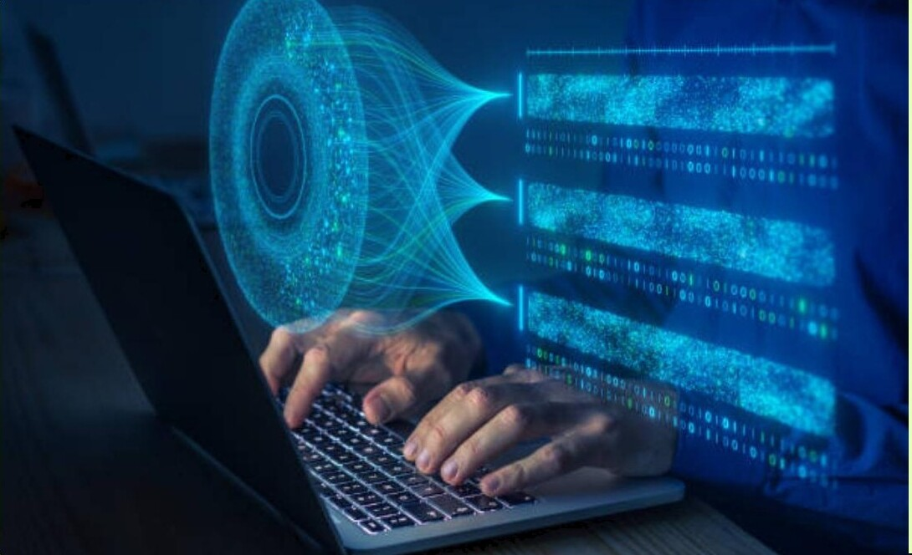
2. DOMAIN NAME
Artificial Intelligence & Computer Vision
Core Focus Areas
The project falls under the broad domain of AI and Computer Vision, specifically focusing on:
1
Deep Learning Algorithms
2
Digital Image Processing
3
Biometric Authentication
4
Pattern Recognition
Project direction: replace manual roll calls with an automated, face-recognition-based smart attendance system.
2

Slide 3
3. REFERENCE BASE PAPER
Real-Time Student Face Recognition Attendance System Using AI
Title
Real-Time Student Face Recognition Attendance System Using AI
Published in
IEEE ICIPRoB 2024 (International Conference)
Objective of Base Paper
To design a scalable attendance system using Haar Cascades and LBPH algorithms for educational institutions.
Key Findings
Achieved a recognition accuracy of 96% and reduced manual attendance time by 85%.
96% recognition accuracy • 85% less manual attendance time
3

Slide 4

4. ABSTRACT
An Automated, Contactless Smart Attendance System
PROBLEM → PROPOSAL
Traditional attendance management, such as roll calls, is time-consuming and prone to proxy attendance. This project proposes an automated Smart Attendance System using real-time facial recognition.
HOW IT WORKS
Utilizing high-definition cameras and deep learning models, the system captures student faces, extracts features, and matches them against a pre-registered database. Attendance is logged automatically in a secure database, providing a seamless, contactless, and fraud-proof solution for modern classrooms.
4

Slide 5
5. MAIN OBJECTIVES
Three Objectives of the Smart Attendance System
1
2
3
Automation
Eliminate Proxy
Real-time Data
To eliminate manual roll calls and automate the entire attendance logging process.
To ensure 100% accuracy and prevent students from marking attendance for others.
To provide instant access to attendance records for faculty and administrators.
Goal: AUTOMATIC + PROXY-FREE + REAL-TIME ATTENDANCE
5

Slide 6
6. PROBLEM STATEMENT
The Inefficiency of Manual Systems
Current paper-based systems are highly inefficient. Professors spend 10–15 minutes of a 50-minute lecture just on roll calls. Furthermore, manual logs are difficult to manage, store, and analyze for long-term records.
1
High Risk
2
Lost Productivity
3
No Real-time Reporting
High risk of manual errors and proxy marking
Loss of productivity for both staff and students
No real-time reporting or parent notification capabilities
Time and accuracy are lost every class — an automated system is needed.
6

Slide 7
7. PROPOSED METHODOLOGY
A Four-Step Face Recognition Pipeline
01
02
03
04
Detection
Encoding
Matching
Logging
▶
▶
▶
Using Haar Cascades or MTCNN to detect human faces in live video streams.
Extracting 128-dimensional facial embeddings for each detected face.
Comparing embeddings with the registered database using Euclidean distance.
Recording the Match ID and Timestamp into the Attendance SQL Database.
Flow: LIVE VIDEO → DETECT → ENCODE → MATCH → LOG ATTENDANCE
7

Slide 8
8. SYSTEM ARCHITECTURE
Our Architecture Follows a Modular Approach
1
2
3
4
5
Input
Processing
Recognition
Storage
Output
▶
▶
▶
▶
A webcam captures live frames
OpenCV processes the image
Deep Learning model identifies the person
SQLite DB updates records
Web interface displays the report
Pipeline: Webcam → OpenCV → Deep Learning model → SQLite database → Web report
LIVE CAPTURE
FACE IDENTIFICATION
AUTO LOGGING
WEB REPORT
8

Slide 9
9. REQUIREMENTS & STACK
Software and Hardware Requirements
Category | Technology / Component
Programming Language | Python 3.x
Computer Vision Library | OpenCV (Open Source Computer Vision)
Deep Learning Models | Haar Cascade, LBPH, or FaceNet
Database Management | SQLite / MySQL / CSV
Hardware Requirement | HD Webcam, 8GB RAM PC, Core i5 Processor
Open-source, low-cost stack that runs on a standard classroom PC.
9

Slide 10
10. PERFORMANCE BENCHMARK
Accuracy Under Common Environmental Variations
Scenario A
30% Accuracy
Scenario B
75% Accuracy
Scenario C
92% Accuracy
Scenario D
97% Accuracy
Accuracy comparison based on common environmental variations (lighting, distance).
10

Slide 11
11. FUTURE SCOPE
Scaling & Security
1
Anti-Spoofing Security
2
Cloud Deployment
Integrating anti-spoofing techniques (liveness detection) to prevent students from using photos to mark attendance.
Deploying the system on Cloud (AWS/Azure) to sync attendance across all departments in the college.
Secure • Scalable • Institution-wide attendance
11

Slide 12
Thank You

